Slide 1
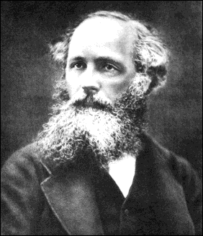
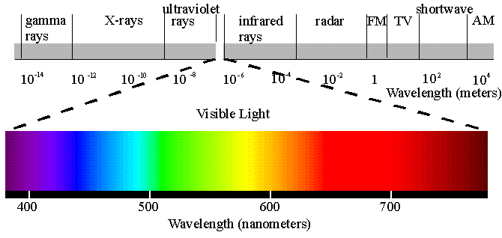
Section 14: Electromagnetic Waves

Slide 2
What is Light?
For centuries, philosophers argued about this.
Does it come from they eye? To the eye?
What is it made out of? Something tangible? Something intangible?
How fast is it? Infinitely fast or does it have a finite speed?
Do different colors travel at different speeds?

Slide 3
Speed of Light Measurements
History of measurements of c (in km/s)
1675 | Rømer and Huygens, moons of Jupiter | 220,000^{[84][105]}
1729 | James Bradley, aberration of light | 301,000^{[90]}
1849 | Hippolyte Fizeau, toothed wheel | 315,000^{[90]}
1862 | Léon Foucault, rotating mirror | 298,000±500^{[90]}
1907 | Rosa and Dorsey, EM constants | 299,710±30^{[95][96]}
1926 | Albert Michelson, rotating mirror | 299,796±4^{[106]}
1950 | Essen and Gordon-Smith, cavity resonator | 299,792.5±3.0^{[98]}
1958 | K.D. Froome, radio interferometry | 299,792.50±0.10^{[102]}
1972 | Evenson et al., laser interferometry | 299,792.4562±0.0011^{[104]}
1983 | 17th CGPM, definition of the metre | 299,792.458 (exact)^{[80]}

Slide 4
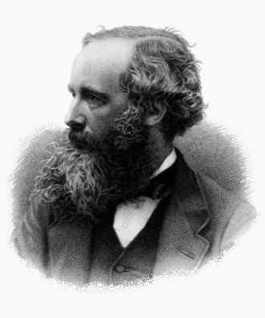
James Maxwell
“We can scarcely avoid the conclusion that light consists in the transverse undulations of the same medium which is the cause of electric and magnetic phenomena”

Slide 5
Generating Electromagnetic Radiation
Must have a source oscillating charge!
Oscillating Charge Animation

Slide 6

Wave Speed, Wavelength and Frequency
$$v=λf$$
For light, the wave speed $v$ is equal to $c$!

Slide 7
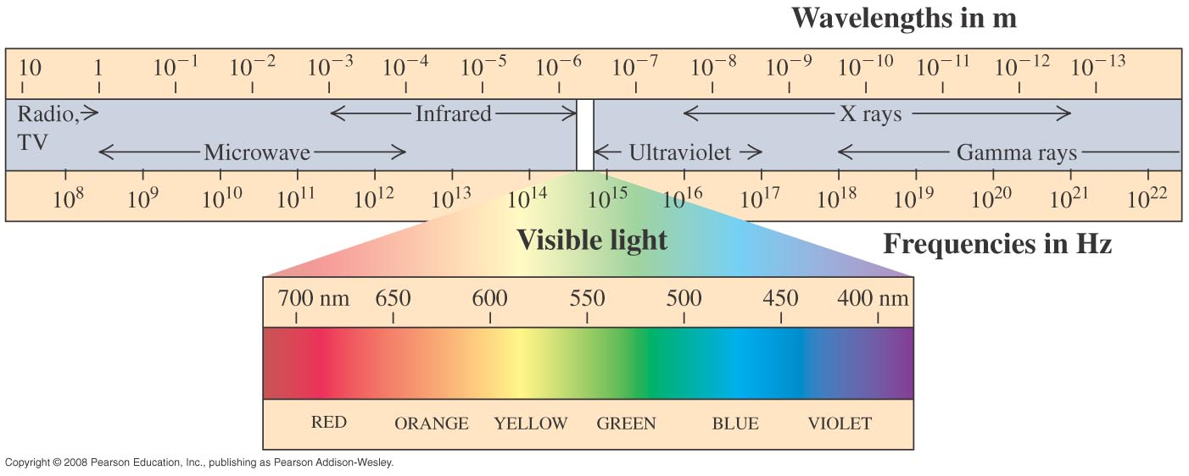
Electromagnetic waves occur over a wide range

Slide 8
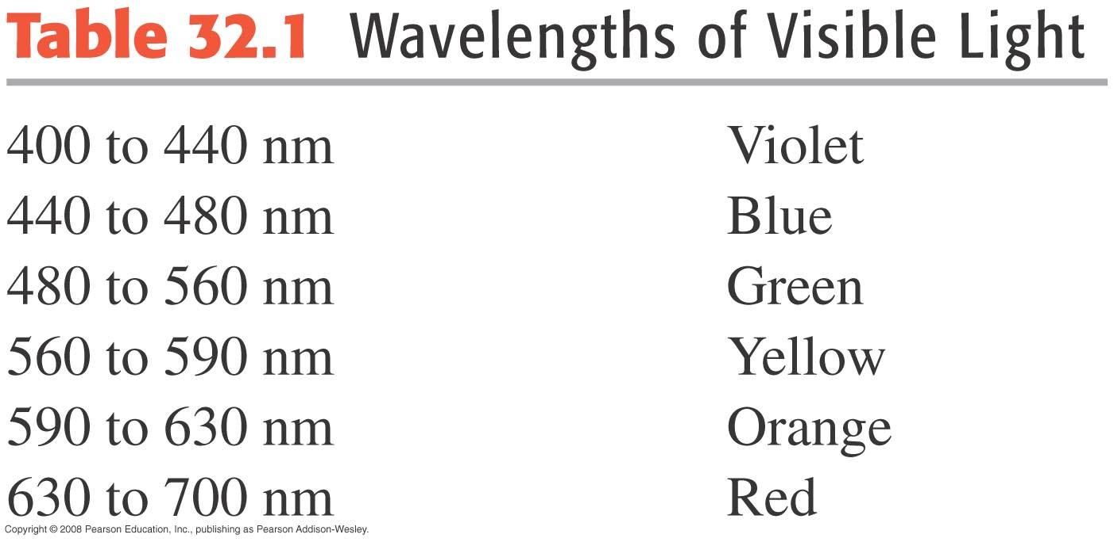
The visible spectrum

Slide 9
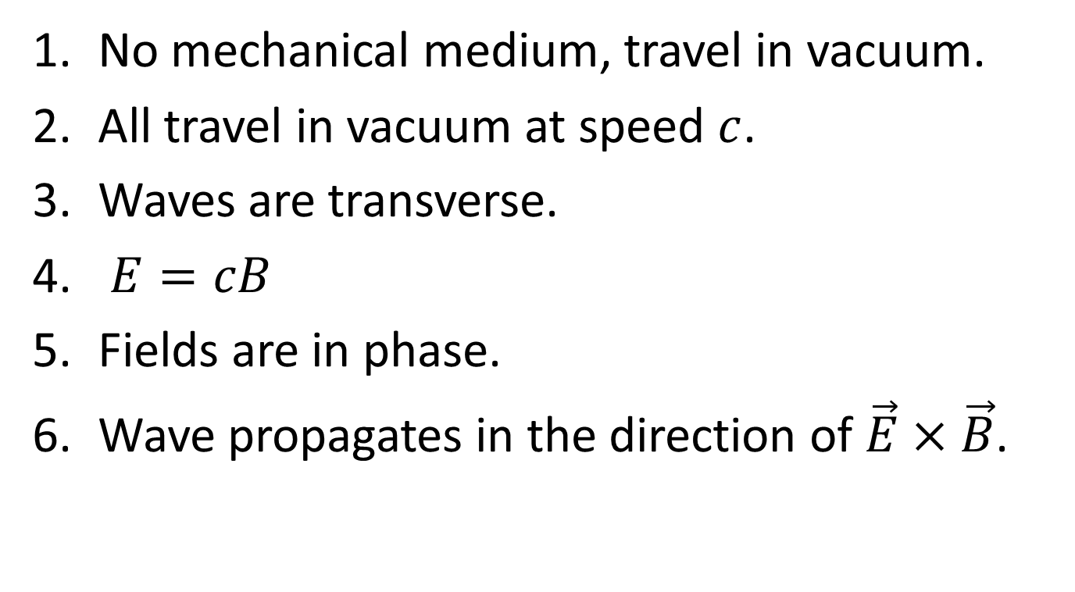
Properties of EM Waves in Vacuum: Summary
No mechanical medium, travel in vacuum.
All travel in vacuum at speed $c$.
Waves are transverse.
$E=cB$
Fields are in phase.
Wave propagates in the direction of $\vec{E}×\vec{B}$.

Slide 10
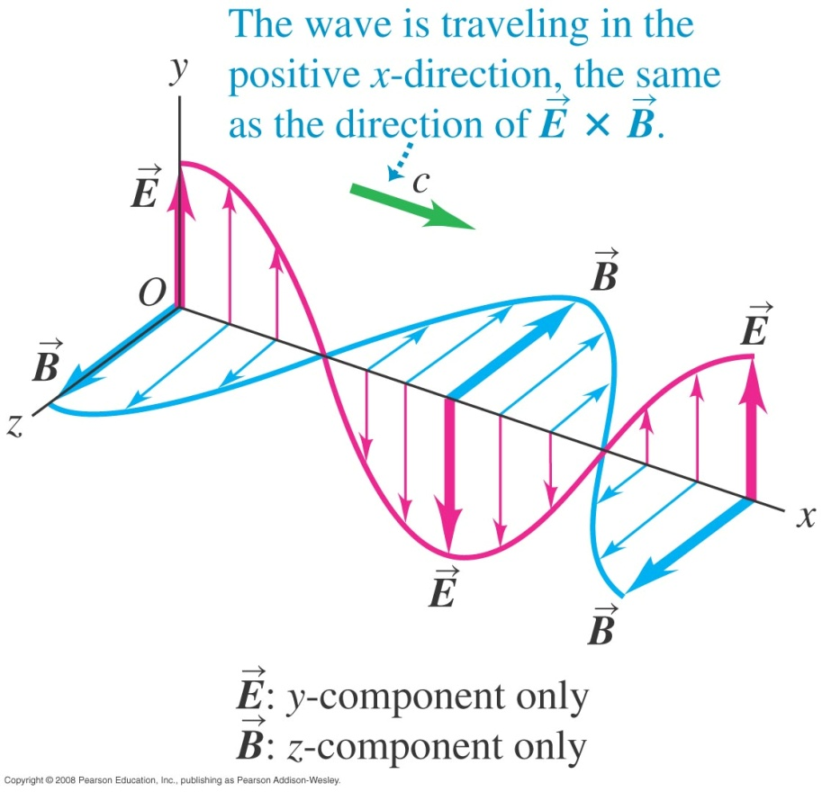
Electromagnetic Plane Wave

Slide 11
Activity: Understanding EM Waves and EM Wave Propagation

Slide 12
Example: The Wave Function for an EM Wave

Slide 13
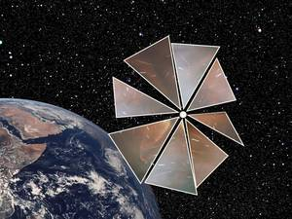

Energy Density in an EM Wave
$$u(t)=u_{E}(t)+u_{B}(t)=\frac{1}{2}ε_{0}{E(t)}^{2}+\frac{1}{2μ_{0}}{B(t)}^{2}$$
$$u(t)=ε_{0}{E(t)}^{2}$$

Slide 14
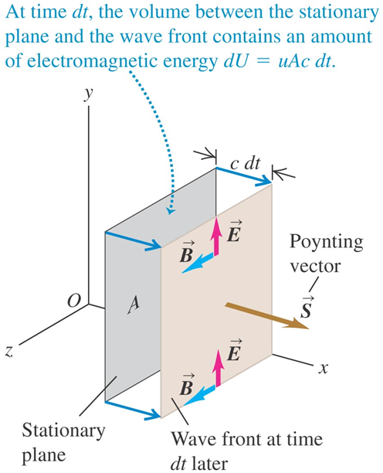

The Poynting Vector
$$S(t)≡\frac{1}{A}\frac{dU}{dt}$$
$\vec{S}(t)=\frac{1}{μ_{0}}\vec{E}(t)×\vec{B}(t)$

Slide 15
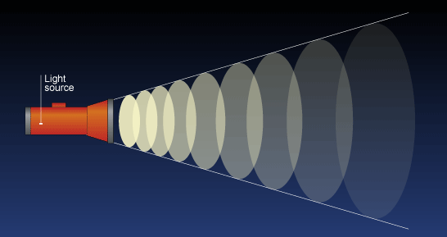

Intensity in an EM Wave
$$I≡S_{avg}=\frac{EB}{2μ_{0}}$$

Slide 16
Intensity in an EM Wave: Activity

Slide 17
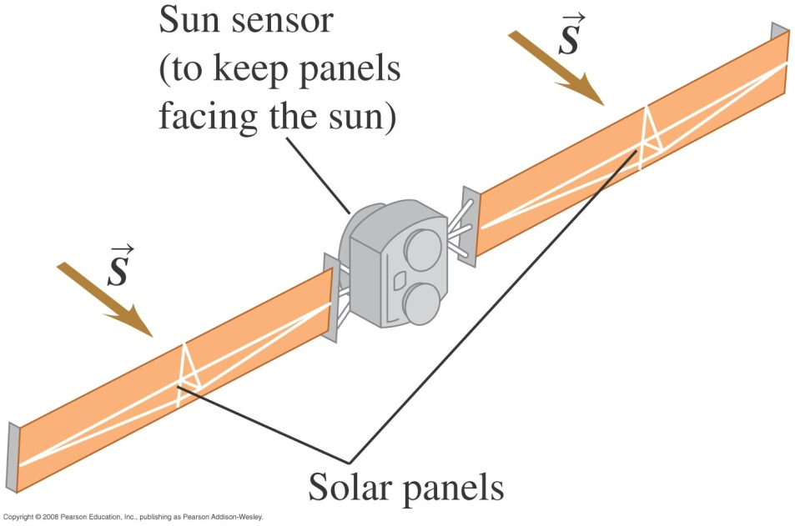
Momentum of an EM Wave
An EM wave carries momentum too!

Slide 18

Solar Sail
At Earth’s location, the pressure from sunlight is approximately 1 $μ$Pa. Very small!
But with a large surface area and a low mass sail, the sail can attain high speeds!

Slide 19
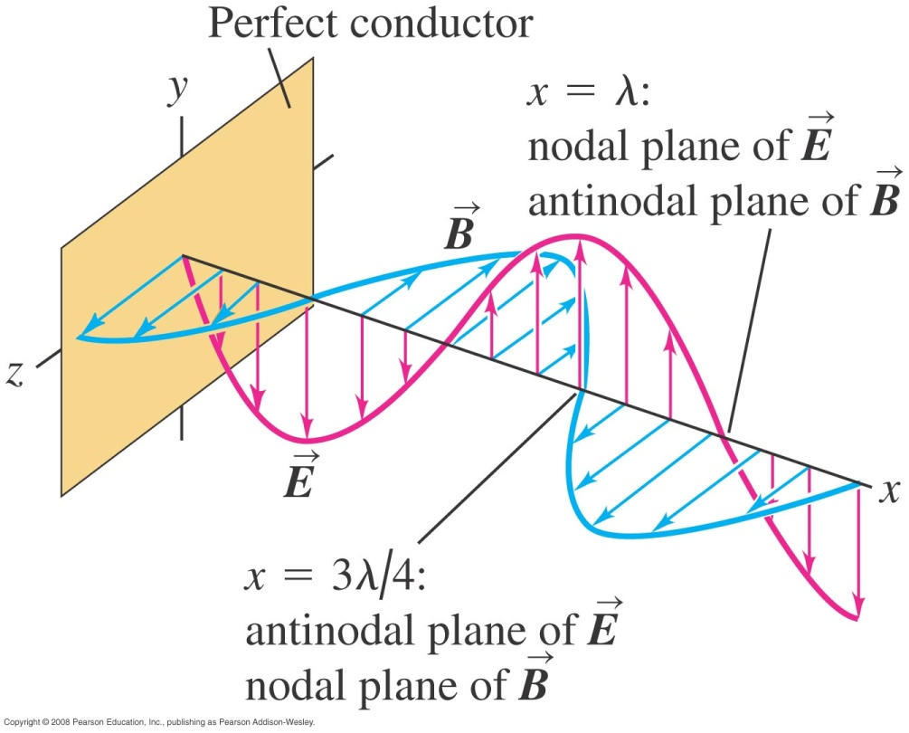
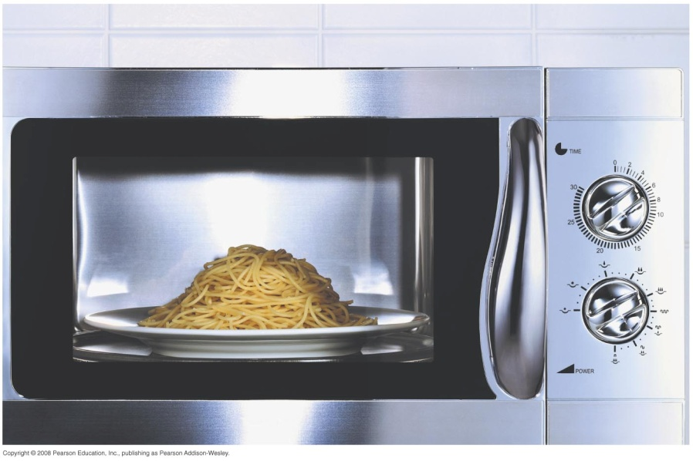
Bounded EM waves
If EM waves reflect off a conductor, we get a standing wave!

Slide 20
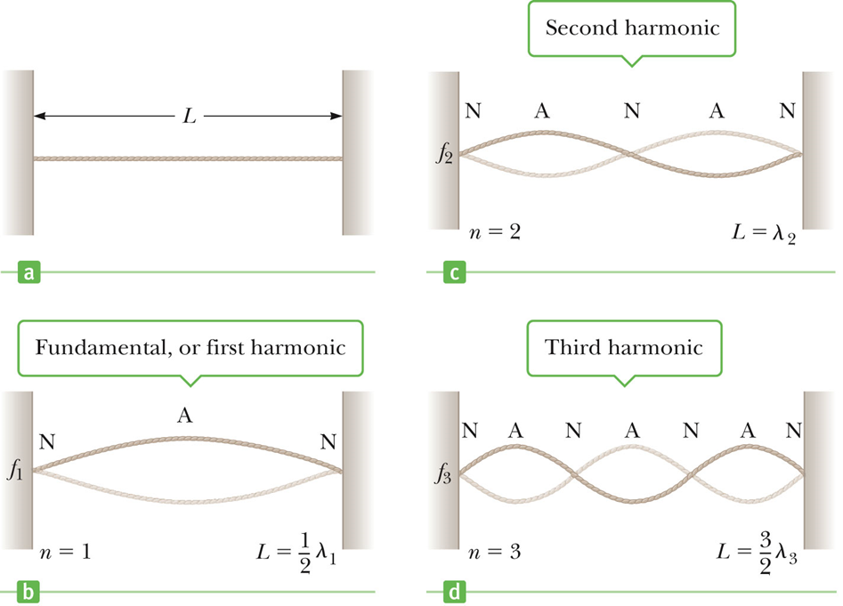
Normal Modes: Standing EM Waves in a Cavity

Slide 21
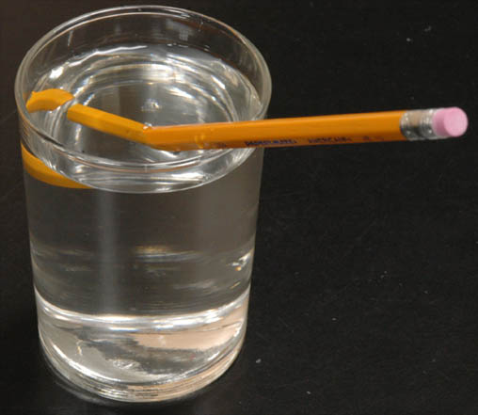

Electromagnetic Waves in Matter
$$v=\frac{c}{n}$$
What is $n$???

Slide 22
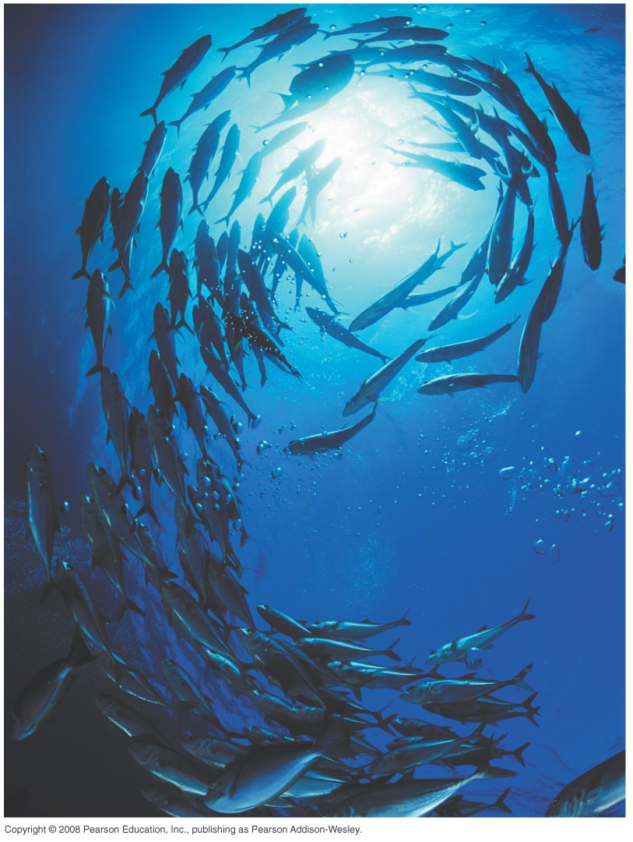
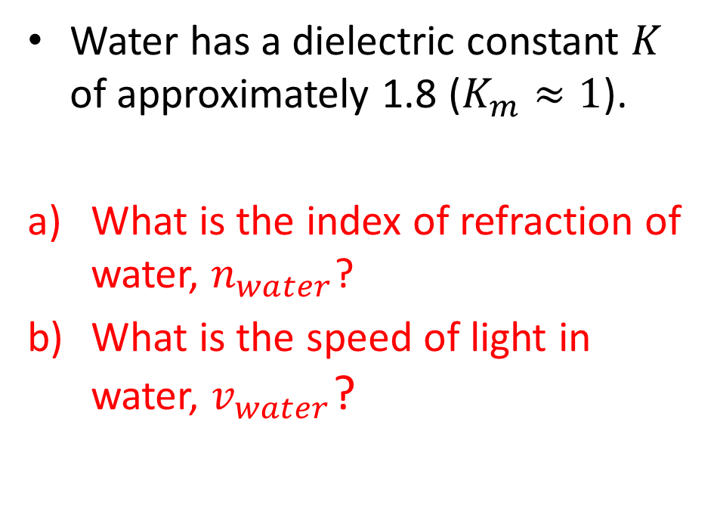
Speed of Light in Water: Example
Water has a dielectric constant $K$ of approximately 1.8 ($K_{m}≈1$).
What is the index of refraction of water, $n_{water}$?
What is the speed of light in water, $v_{water}$?

Slide 23
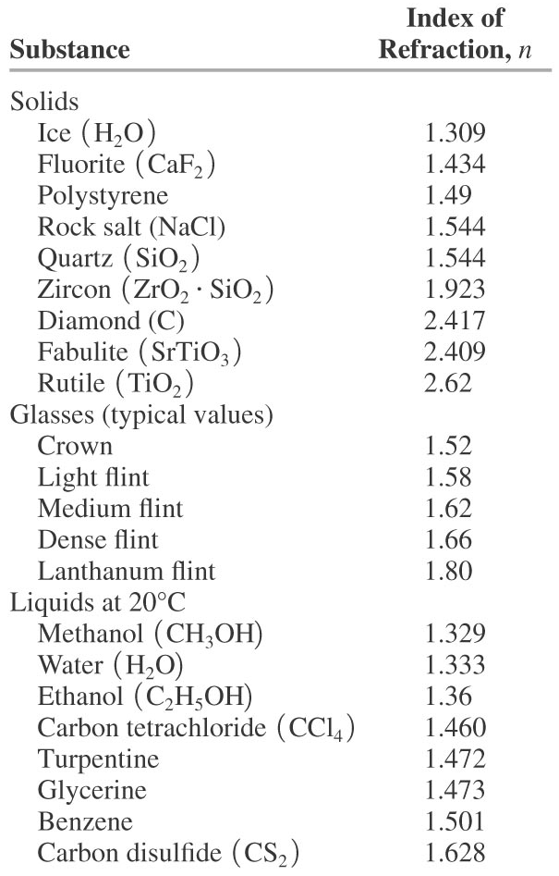
Tabulated indexes of refraction

